Slide 1
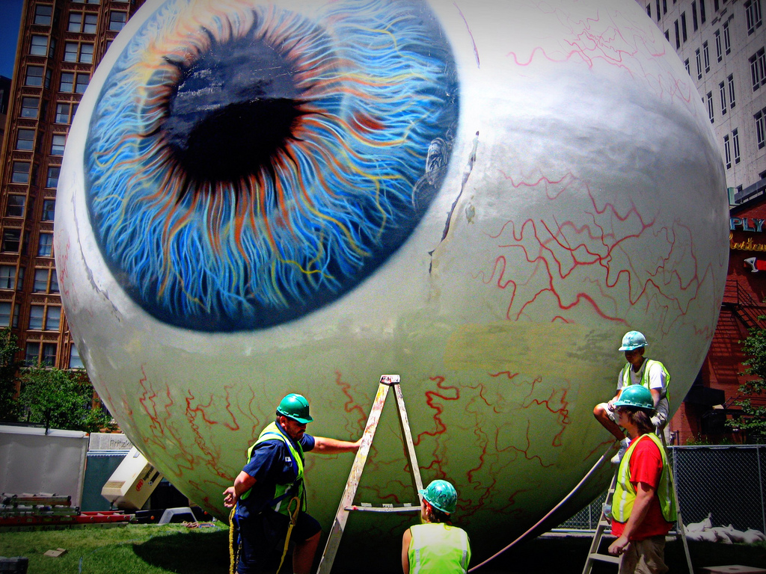

Vision
[Class Section Number]
[Instructor Name]
Notes:
Vision is ideally taught over 1-class period.
There are a couple of approaches you can take. First, you can focus on the chapter alone. The complexity of the visual system is more than enough to fill a class period. Alternatively, you could choose to go somewhat quickly through the text materials and instead spend the bulk of class in activities demonstrating various visual phenomena. The information covered is the same in either option.
Warmup discussion: Ask students why they think the senses are important to our understanding of the world. Spend a few minutes talking about the importance of all the senses then guide the discussion to vision and its importance.

Slide 2
Overview
What is Vision?
Contrast is Key
Sensitivity to Light
Reconstruction
Color
Integration
Notes:
The purpose of this slide is to provide students with an overview of the material that will be covered during the lecture.
Technical Note: These slides may contain simple click animation so that you can focus students’ attention on a particular question, a selection of text, or an image and not have them be distracted by reading ahead. You can either preview the sequence of animation by going through the slides in slideshow view, visiting the animations tab, or reviewing the slide notes. In the notes you will see a cue - (Click) – that corresponds to each animation.
You will also find hyperlinks to outside videos at various places in the slides. These hyperlinks are embedded in text and indicated by color and in the notes section.

Slide 3
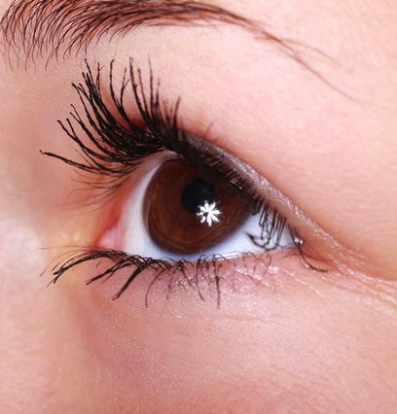
What is Vision?
Light
Photo-Receptor
Photo-Activation
Neural
Activity
Awareness
Notes:
This slide broadly describes the visual system including how light goes from simply existing into our conscious awareness.
Instructor’s note: Give students a brief overview of how light that we are exposed to travels through the pupil and lands on a photoreceptor. This causes photoactivation (a process that occurs when light hits a photo receptor causing a series of neural activities to occur and eventually, a few milliseconds later, we become aware of the light.

Slide 4
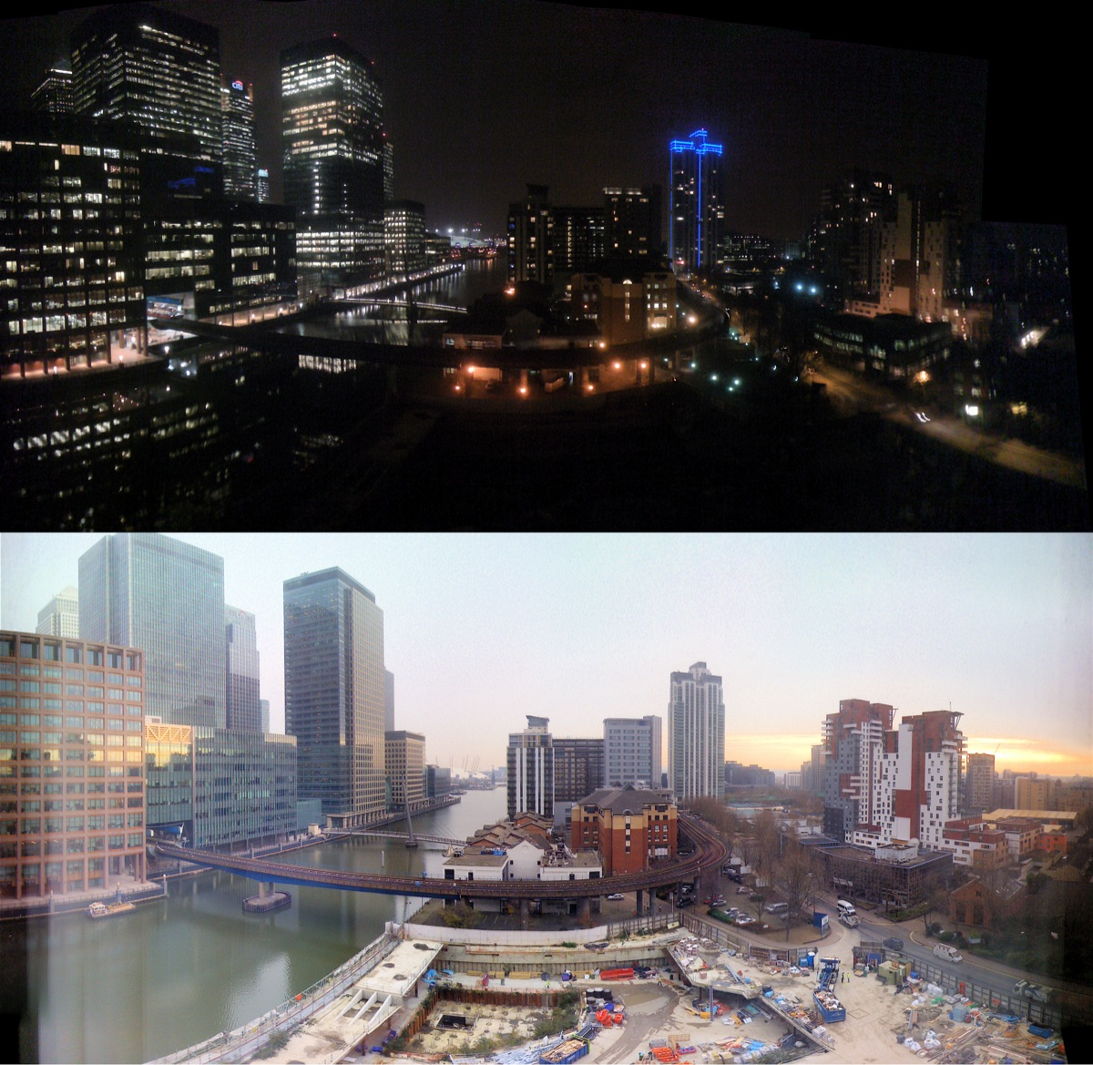
What is Vision? Photoreceptors
Rods
Dim Light
Cones
Bright Light
Fine Detail
Notes:
This slide illustrates the utility of each type of photoreceptor – rods and cones – to students.
Instructor’s note: Explain the function of rods and cones:
(Click) Rods give us sensitivity under dim lighting conditions and allow us to see at night. Rods populate the periphery (the region surrounding the fovea) and are almost absent from the fovea.
(Click) Cones allow us to see fine details in bright light and give us the sensation of color. Cones are tightly packed around the fovea (the central region of the retina behind your pupil) and more sparsely elsewhere.
Optional demonstration: For an illustration of the anatomy of the eye, visit this site: http://www.eyecareamerica.org/eyecare/anatomy/.

Slide 5
Overview
What is Vision?
Contrast is Key
Sensitivity to Light
Reconstruction
Color
Integration
Notes:
The purpose of this slide is to provide students with an overview of the material that will be covered during the lecture.

Slide 6
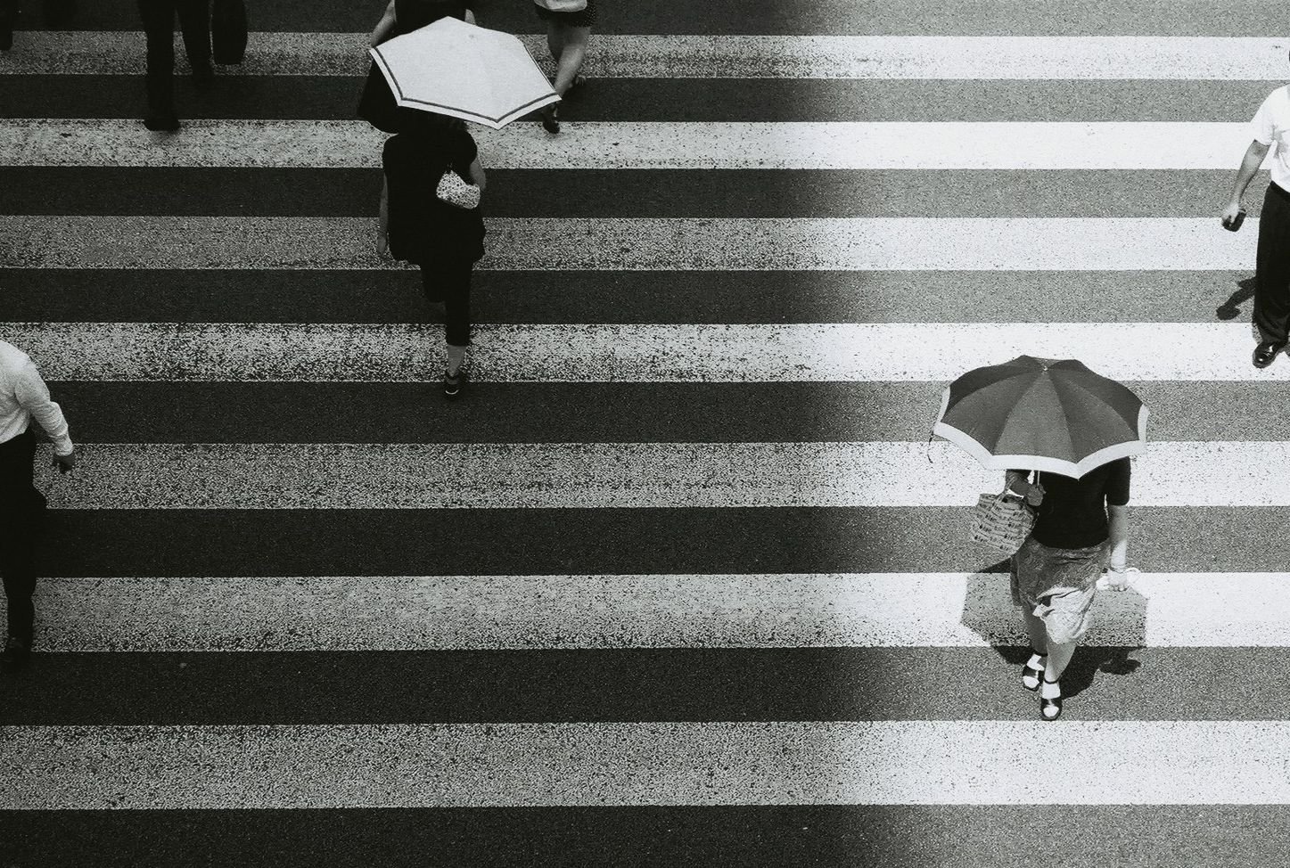
Contrast is Key
Contrast ➔ Lateral Inhibition
Notes:
This slide illustrates the importance of contrast in the visual system.
Discussion question: Why do you think contrast between light and dark matters to our ability to see?
Explanation: As soon as photoreceptors capture light, the nervous system gets busy analyzing differences in light, and it is these differences that get transmitted to the brain. The brain, it turns out, cares little about the overall amount of light coming from a specific part of the world, or in the scene overall. Rather, it wants to know this: Does the light coming from this one point differ from the light coming from the point next to it?

Slide 7
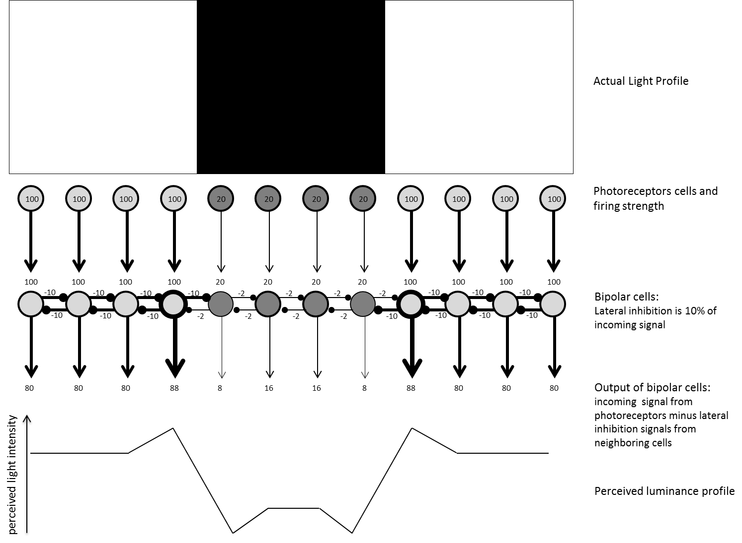
Contrast is Key: Lateral Inhibition
Notes:
This slide describe this figure from the text, which is an illustration of lateral inhibition
Contrast is so important that your neurons go out of their way not only to encode differences in light but to exaggerate those differences for you, lest you miss them. Neurons achieve this via a process known as lateral inhibition.
Discussion questions: What do you remember about lateral inhibition from your reading?
Explanation: When a neuron is firing in response to light, it produces two signals:
An output signal to pass on to the next level in vision
A lateral signal to inhibit all neurons that are next to it. Nearby neurons are likely responding to the same light coming from nearby locations, so this information is somewhat redundant. The magnitude of the lateral inhibitory signal a neuron produces is proportional to the excitatory input that neuron receives: the more a neuron fires, the stronger the inhibition it produces.
Explanation of image: The top of the figure shows a black stripe on a white background. The first row of circles illustrates photoreceptors responding in a graded fashion: the more light hits them, the more they fire. The numbers inside the circles represent how much these cells are firing, and the thickness of lines is also meant to illustrate the strength of neural firing.
These photoreceptors activate the next layer of neurons in the retina: bipolar cells. These cells produce lateral inhibition signals, depicted by the horizontal lines that end with a small circle. The inhibition signals are proportional (here, 10% for ease) to the excitatory input they receive. Cells receiving 100 units will inhibit their neighbors by 10 units. Cells receiving 20 units will inhibit their neighbors by 2 units. The output of a bipolar cell will be determined by the input it receives minus all the lateral inhibition signals from its neighbors. As a result of the inhibition, notice how on the bright side of the edges, the firing rates are the highest (88) compared to nearby neurons just coding bright light (80).
These higher values near the edge occur because these cells receive a comparatively small amount of inhibition from their “dark-side” neighbor (-2). Similarly, on the dark side of the edge, the firing rates are the lowest (8) of all the dark region (16) because these cells receive a comparatively large amount of inhibition from their “bright-side” neighbor (-10). Overall, the image is coded as a black stripe surrounded by brighter light, but now, thanks to lateral inhibition, all the edges in the image have been emphasized (enhanced), as illustrated by the perceived luminance profile at the bottom of the image.
Discussion question: Now that we’ve looked at this illustration of how lateral inhibition works in the eye, why do you think it is so important to our ability to see?

Slide 8
Overview
What is vision?
Contrast is Key
Sensitivity to Light
Reconstruction
Color
Integration
Notes:
The purpose of this slide is to provide students with an overview of the material that will be covered during the lecture.

Slide 9
Sensitivity to Light
Movie Theater
Afternoon Sun
Rods Bleached
Cones Activated
Afternoon Sun
Movie Theater
Dark Adaptation
Contrast Gain
Notes:
This slide illustrates some of the visual phenomena that arise out of our sensitivity to light.
(Click) Movie theater > Afternoon sun
Discussion question: What happens to your vision when you walk out of a movie theater into the afternoon sun?
Likely answer: It’s bright and it’s hard to see.
Further discussion: Ask students to consider what might cause this reaction. Students might state that the dark theater causes the eye to adjust to try to take in more light, so when you leave the theater, the eye has to quickly readjust so as not to take in too much light all at once, making it difficult to see.
(Click) Rods bleached; cones activated
Explanation: It’s hard to see because our rods become bleached. However, after about 1 second, our eyes adapt to the light and our cones begin to increase activity.
(Click) Afternoon sun > movie theater
Discussion question: Conversely, what happens when you move from the afternoon sun into a dark theater?
(Click) Dark adaptation
Explanation: When moving into a dark environment, rods must become more activated, a process that can take up to 30 minutes to occur. This explains why at first you may not be able to see in a movie theatre, but after a few moments you being to see objects around you more clearly.
(Click) Contrast gain
Demonstration: Show students the following website for a fun demonstration of contrast gain: http://www.michaelbach.de/ot/lum_contrast-adapt/.
Explanation: Contract gain occurs when the visual system determines the mean contrast in a scene and represents values around that mean contrast best, while ignoring smaller contrast differences.

Slide 10
Overview
What is Vision?
Contrast is Key
Sensitivity to Light
Reconstruction
Color
Integration
Notes:
The purpose of this slide is to provide students with an overview of the material that will be covered during the lecture.

Slide 11
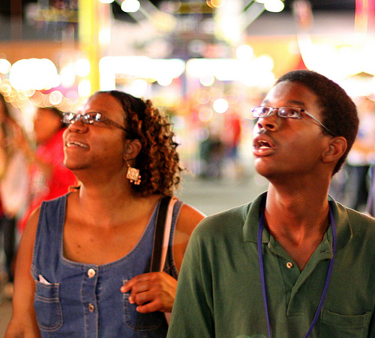
Reconstruction
Neurons
Thalamus
Reflexive Eye Movements
Primary Visual Cortex
Notes:
This slide illustrates the pathway of neural activation as it moves from the neurons and makes its way to the primary visual cortex.
(Click) Neurons
Explanation: Neurons project visual information first into the thalamus, in a section known as the lateral geniculate nucleus.
(Click) Thalamus
Explanation: From here, the information splits and projects towards two different parts of the brain. Most of the computations regarding reflexive eye movements are computed in subcortical regions, the evolutionarily older part of the brain.
(Click) Reflexive eye movements
Explanation: Reflexive eye movements allow you to quickly orient your eyes towards areas of interest and to track objects as they move.
(Click) Primary visual cortex
Explanation: The more complex computations, those that eventually allow you to have a visual experience of the world, all happen in the cortex, the evolutionarily newer region of the brain. The first stop in the cortex is at the primary visual cortex where the reconstruction process begins.

Slide 12
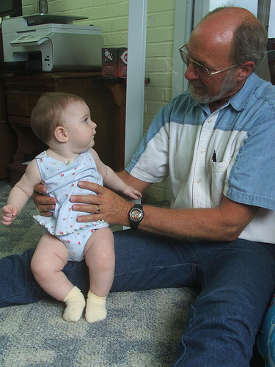
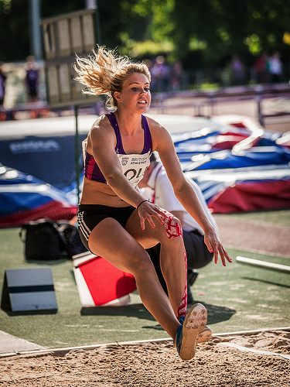
Reconstruction: Primary Visual Cortex
Ventral Pathway
Dorsal Pathway
“What Pathway”
Recognition
“Where and How Pathway”
Self & Object Motion
Notes:
This slide illustrates the two primary pathways in the visual cortex, ventral and dorsal.
Instructor’s note: Briefly explain the ventral and dorsal pathways before asking students to discuss these concepts.
Explanation: Visual-recognition areas are located along the ventral pathway of the brain (also known as the “What Pathway”). Other brain regions along the dorsal pathway (or “Where-and-How Pathway”) will compute information about self and object motion, allowing you to interact with objects, navigate the environment, and avoid obstacles.
Discussion question: What might happen if one of these pathways wasn’t working properly?
Possible Answer: People might have a hard time avoiding hazards in their environments.

Slide 13
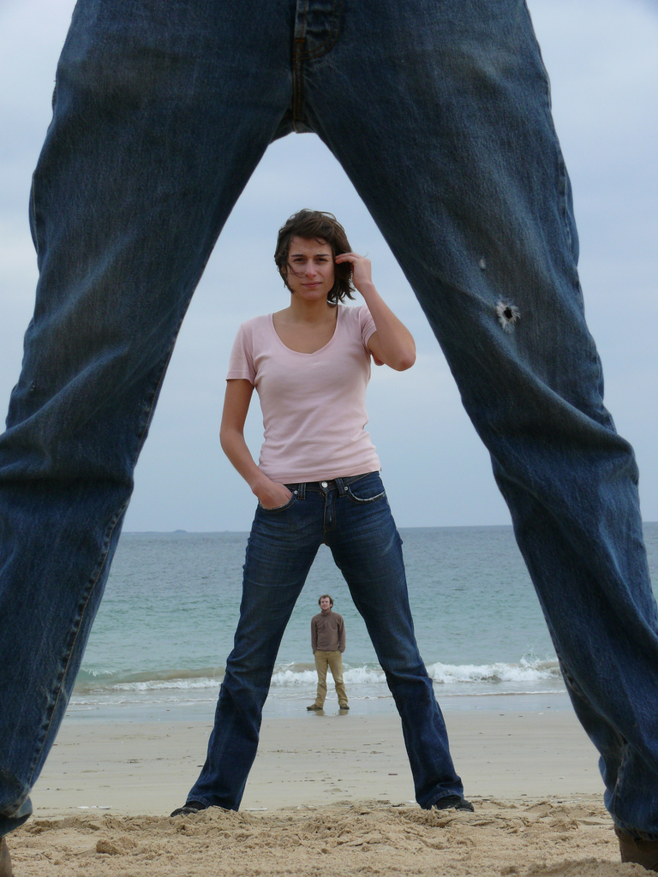
Reconstruction
Binocular Advantage
Creates 3D Image
Volume
Distance
Size
Notes:
This slide discusses the concept of binocular advantage.
Instructor’s note: Begin by giving a brief description of the utility of having two eyes rather than just one:
Having two eyes provides you with two chances at catching a signal in front of you
The minute difference in perspective that you get from each eye helps your brain reconstruct the sense of three-dimensional space.
You can get an estimate of how far distant objects are from you, their size, and their volume.
Demonstration: This illustrates the concept of a binocular advantage and the function of each eye seeing a slightly different image while our brains perceive one image.
Have students hold their thumbs out in front of them making a thumbs up.
Then tell them to close one eye.
Next ask students to switch.
Then have them switch back and forth.
They should all see their thumb jumping because each eye has a different perspective of their thumb.

Slide 14
Overview
What is vision?
Contrast is Key
Sensitivity to Light
Reconstruction
Color
Integration
Notes:
The purpose of this slide is to provide students with an overview of the material that will be covered during the lecture.

Slide 15
Color: Photoreceptors
Color varies by species.
Quiz
2, 3, 4, 16
Chickens
Mantis Shrimp
Dogs
Humans
Trichromacy Theory
S-cones ➔
M-cones ➔
L-cones ➔
Notes:
This slide illustrates the principle of color and how it is perceived.
Instructor’s note: Begin by having students guess the visual systems of different species using the slide as a reference.
Activity: The numbers shown on the slide represent the number of photoreceptors different species have. As you click to reveal each animal, ask students to guess how many photoreceptors each one has. Don’t give them the correct answers until you’ve revealed all four animals.
(Click) Chickens
(Click) Mantis shrimp
(Click) Dogs
(Click) Humans
Answers:
Chickens have 4
Mantis shrimp have 16
Dogs only have 2
Humans have 3
How then do we see such variation in colors?
(Click) The Trichromacy theory proposed that the eye had three different types of color-sensitive cells based on the observation that any one color can be reproduced by combining lights from three lamps of different hue. Indeed, human retinas have three types of cones: S-cones, M-cones, and L-cones (also known as blue, green, and red cones, respectively) that are sensitive to three different wavelengths of light.
This principle is used today on TVs, computer screens, and any colored display. If you look closely enough at a pixel, you will find that it is composed of a blue, a red, and a green light, of varying intensities.

Slide 16
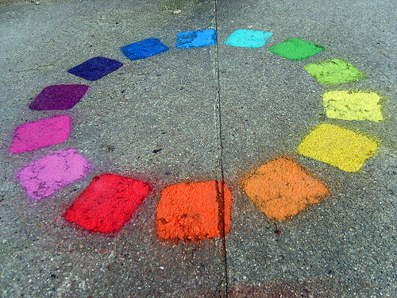
Color: Opponent Process Theory
Opponent Process Theory of Color
Color Blindness
Cultural Effect
Red
Green
Blue
Yellow
Black
White
Notes:
This slide illustrates the concept of the opponent process theory of color.
Instructor’s note: Begin by briefly describing the opponent process theory of color in which color is coded via three opponent channels (red-green, blue-yellow, and black-white). They are considered “opponents” because they do not exist (e.g., you can have a reddish-blue but not a reddish-green). If you have equal parts of the two colors you get grey. If you have unequal parts, you see the stronger color. Colors are encoded as differences between two hues and not as simple combinations of hues. Again, what matters to the brain is contrast. Contrast, as students should recall, is important also in the perception of light.
Discussion topics:
Ask students for some examples of how they categorize colors.
(Click) Color blindness
What if someone is colorblind; how does that affect color knowledge? In color blindness, people are missing one or more type of cone in their retina. The most common type of color-blind is Red-Green color blindness, this most often occurs in men.
(Click) Cultural effect
Talk about cultural differences. Not all cultures categorize colors in the same way, for example. And some groups “see” different shades of what people in the Western world would call the “same” color, as categorically different colors.
Ask how many students speak a second language. Ask students to name different color words for blue (in Japanese blue and green are the same, in Russian there are different words for dark and light blue). You could also ask for yellow or green. How many words are there in other languages to describe what English really only has one word for? What does this perception in color difference mean?

Slide 17
Color: Opponent Process Theory
Notes:
This slide demonstrates the concept of the opponent process theory.
Instructor’s note: Tell students to look at the target. After 30 seconds to one minute switch to the next slide and ask students what color target they see on the blank screen. They should see a green or yellow target. (They may need to look at the blank screen for a few seconds before anything happens.)

Slide 18
Color: What Do You See?
Notes:
This slide allows students to see the after image from the activity on the preceding slide.
Instructor’s note: Ask students what color target they see now. They will likely see a green and yellow target.

Slide 19
Overview
What is vision?
Contrast is Key
Sensitivity to Light
Reconstruction
Color
Integration
Notes:
The purpose of this slide is to provide students with an overview of the material that will be covered during the lecture.

Slide 20
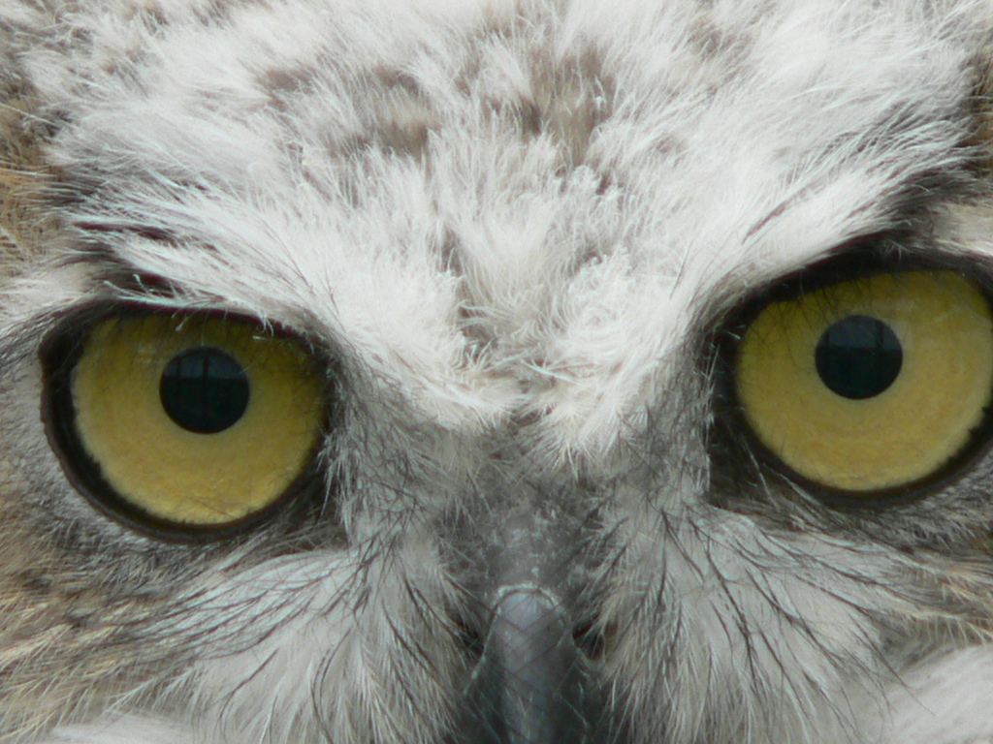
Integration with Other Modalities
Vestibulo-Ocular Reflex
Synesthesia
Notes:
This slide illustrates the integration of the visual processing system with other modalities.
Instructor’s note: Tell students to have a staring contest with the owl. Tell them to turn their heads from side to side but don’t break contact with the owl’s eyes. Most if not all students will be able to do this.
(Click) Vestibulo-Ocular Reflex
Explain that students are actively using their vestibulo-ocular reflex. This shows how vision does not work independently of other systems in the body. It interacts with and depends on other sensory modalities. The vestibule-ocular reflex is achieved by integrating information from both the visual and the vestibular system (which knows about body motion and position).
(Click) Synesthesia – Click on this word in the slide to watch the four-minute video about synesthesia.
Activity: Ask students to draw a picture for close synonyms (Example: ecstasy and rapture - Most people draw ecstasy like a sunburst or a sun rising, and rapture like some sort of spiral or squiggle). Then have the students compare similarities in their pictures with their neighbors’ pictures. Then with the whole class talk about what similarities were found, why people drew similar images, and why certain colors seem to represent certain concepts among a wide range of people.
Discussion question: How does this activity help us better understand the ways in which vision integrates with other modalities to process information?

Slide 21
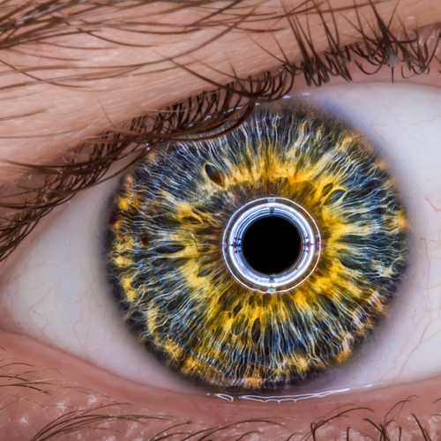
Conclusion
Notes:
This slide introduces students to inattentional blindness and asks students to think like researchers to help them better understand the complexities of learning about our own visual system.
Demonstrations: To give students illustrations of inattentional blindness, incorporate the following videos and activities into the conclusion of this class session:
Color changing card trick video (2:44): http://youtu.be/v3iPrBrGSJM
Discussion: Stop the video as soon as the first pass is done, (before the text: “This is NOT about the cards”). Ask the students how the host did the trick. They will likely say that he changed cards when we couldn’t see his hands because of how the camera cropped and panned. They will be right, but the more important message is about how our attention can be directed. Then ask if anyone saw other changes. And show the rest of the video.
Whodunnit? Video (1:54) https://www.youtube.com/watch?v=ubNF9QNEQLA
Discussion: Stop the video after the question “Did you notice the 21 changes.” Ask if anyone noticed changes and list any remembered. At this point you can continue playing the video and see the changes. Or go back to the beginning and ask students to see how many they can write down. This time let the clip play until the end. This video was part of a London ad campaign to watch out for cyclists.
Instructor’s note: Emphasize how incredibly complex the visual system is in humans. Researchers have only just begun to get a functional understanding of the visual system. It is not sufficiently evolved for us to recreate artificial visual systems (i.e., we still cannot make robots that “see” and understand light signals as we do), but we are getting there. There are new breakthroughs being made all the time in the area of vision. One current research endeavor is exploring how we as humans are able to use the visual system to predict what is going to happen (e.g., hitting a 90mph fast-ball).
Optional discussion question (if time permits): Imagine you were given the task of testing the color-perception abilities of a newly discovered species of monkeys in the South Pacific. How would you go about it?
Instructor’s note: Answers will be varied and complex. Be sure to make the connection to how difficult it is to gain new understanding about our own biological systems.

Slide 22
Photo Attribution
Slide 1 | Photo Credit: clarkmaxwell https://www.flickr.com/photos/9436716@N04/4745939931/ https://creativecommons.org/licenses/by-nc-nd/2.0/
Slide 3 | PhotoCredit: PublicDomainPictures. http://pixabay.com/en/beautiful-close-up-eye-eyebrows-2315/ http://creativecommons.org/publicdomain/zero/1.0/deed.en
Slide 4 | Photo Credit: InnerCore https://www.flickr.com/photos/27935298@N03/4369908087/ https://creativecommons.org/licenses/by-nc-sa/2.0/
Slide 4 | Photo Credit: jenny downing https://www.flickr.com/photos/7941044@N06/7793564866/ https://creativecommons.org/licenses/by/2.0/
Slide 6 | Photo Credit: im nothing in particular https://www.flickr.com/photos/50319174@N08/6135878766/ https://creativecommons.org/licenses/by-nd/2.0/
Slide 11 | Photo Credit: kevin dooley https://www.flickr.com/photos/12836528@N00/2966983310/ https://creativecommons.org/licenses/by/2.0/
Slide 12 | Photo Credit: OhKyleL https://www.flickr.com/photos/57215516@N00/2622128789/ https://creativecommons.org/licenses/by-nc-nd/2.0/
Slide 12 | Photo Credit: jimbo0307 https://www.flickr.com/photos/48520501@N02/14219440492/ https://creativecommons.org/licenses/by-nc-sa/2.0
Slide 13 | Photo Credit: BasileLeConquerant https://www.flickr.com/photos/45772611@N00/2092722825/ https://creativecommons.org/licenses/by-nc/2.0/
Slide 16 | Photo Credit: Romain [ apictureourselves.org ] https://www.flickr.com/photos/72898690@N00/421118235/ https://creativecommons.org/licenses/by-nc-sa/2.0/
Slide 20 | Photo Credit: johnmuk https://www.flickr.com/photos/52538087@N00/173961915/ https://creativecommons.org/licenses/by-nc-sa/2.0/
Slide 21 | Photo Credit: Tc Morgan https://www.flickr.com/photos/63114962@N08/8071352735/ https://creativecommons.org/licenses/by-nc-sa/2.0/
Notes:
This slide introduces students to inattentional blindness and asks students to think like researchers to help them better understand the complexities of learning about our own visual system.
Demonstrations: To give students illustrations of inattentional blindness, incorporate the following videos and activities into the conclusion of this class session:
Color changing card trick video (2:44): http://youtu.be/v3iPrBrGSJM
Discussion: Stop the video as soon as the first pass is done, (before the text: “This is NOT about the cards”). Ask the students how the host did the trick. They will likely say that he changed cards when we couldn’t see his hands because of how the camera cropped and panned. They will be right, but the more important message is about how our attention can be directed. Then ask if anyone saw other changes. And show the rest of the video.
Whodunnit? Video (1:54) https://www.youtube.com/watch?v=ubNF9QNEQLA
Discussion: Stop the video after the question “Did you notice the 21 changes.” Ask if anyone noticed changes and list any remembered. At this point you can continue playing the video and see the changes. Or go back to the beginning and ask students to see how many they can write down. This time let the clip play until the end. This video was part of a London ad campaign to watch out for cyclists.
Instructor’s note: Emphasize how incredibly complex the visual system is in humans. Researchers have only just begun to get a functional understanding of the visual system. It is not sufficiently evolved for us to recreate artificial visual systems (i.e., we still cannot make robots that “see” and understand light signals as we do), but we are getting there. There are new breakthroughs being made all the time in the area of vision. One current research endeavor is exploring how we as humans are able to use the visual system to predict what is going to happen (e.g., hitting a 90mph fast-ball).
Optional discussion question (if time permits): Imagine you were given the task of testing the color-perception abilities of a newly discovered species of monkeys in the South Pacific. How would you go about it?
Instructor’s note: Answers will be varied and complex. Be sure to make the connection to how difficult it is to gain new understanding about our own biological systems.

